Slide 1
WELCOME

Slide 2
WELCOME

Slide 3
WELCOME

Slide 4
TEAM
WELCOME
CRYPTIC CODEX

Slide 5












CRYPTIC CODEX
Fahim
Audhira
Lutful
Jannat
Samia
samia_672
SAMIA ZAMAN
samia.zaman.251@northsouth.edu
samiazaman56

Slide 6
Text-Based Adventure
C Programming Odyssey
Embark on a journey through code. Discover the creation of a text-based adventure game. Explore the methodology, challenges, and future of this C programming project.

Slide 7
Shadows of the forsaken

Slide 8
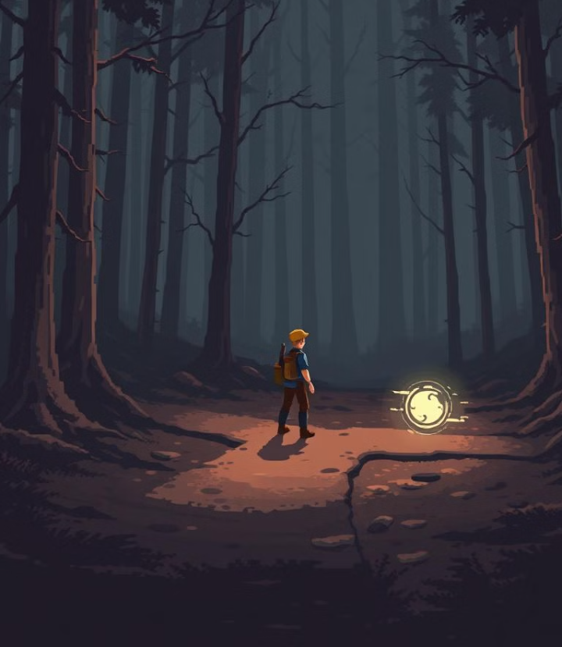
Shadows of the forsaken
INTERACTIVE NARATIVE
Engage in a branching storyline.
Make choices that shape your adventure.
C PROGRAMMING CORE
Built entirely in C. Optimized for performance and resource management.

Slide 9
Shadows of the forsaken
INTERACTIVE NARATIVE
Engage in a branching storyline.
Make choices that shape your adventure.
C PROGRAMMING CORE
Built entirely in C. Optimized for performance and resource management.
RETRO AESTHETICS
Classic text-based interface. Evokes nostalgia for early computer games

Slide 10
Immersive Story
Player Agency
Your decisions matter. Multiple endings based on your choices.
Shadows of the forsaken
C PROGRAMMING CORE
Built entirely in C. Optimized for performance and resource management.
RETRO AESTHETICS
Classic text-based interface. Evokes nostalgia for early computer games
IMMERSIVE STORY
A rich, detailed world. Uncover secrets and face challenging quests.

Slide 11
Immersive Story
Player Agency
Your decisions matter. Multiple endings based on your choices.
Shadows of the forsaken
C PROGRAMMING CORE
Built entirely in C. Optimized for performance and resource management.
IMMERSIVE STORY
A rich, detailed world. Uncover secrets and face challenging quests.
PLAYER AGENCY
Your decisions matter. Multiple endings based on your choices.
RETRO AESTHETICS
Classic text-based interface. Evokes nostalgia for early computer games

Slide 12
Immersive Story
Player Agency
Your decisions matter. Multiple endings based on your choices.
Shadows of the forsaken
C PROGRAMMING CORE
Built entirely in C. Optimized for performance and resource management.
IMMERSIVE STORY
A rich, detailed world. Uncover secrets and face challenging quests.
PLAYER AGENCY
Your decisions matter. Multiple endings based on your choices.
RETRO AESTHETICS
Classic text-based interface. Evokes nostalgia for early computer games

Slide 13




FROM CONCPET TO CODE
IDEA
DESIGN
DEBUGGING
CODE

Slide 14
CRYPTIC CODEX
Fahim
Audhira
Lutful
Jannat
Samia
samia_672
SAMIA ZAMAN
samia.zaman.251@northsouth.edu
samiazaman56

Slide 15


CRYPTIC CODEX
Fahim
Siam
Lutful
Jannat
Audhira
sunnah_75
AUDHIRA MUNTAHA
Audhira.muntaha.251@northsouth.edu
audhira251

Slide 16

DISCOVER
SHADOWS OF THE FORSAKEN

Slide 17
DISCOVER
SHADOWS OF THE FORSAKEN

Slide 18
DISCOVER
SHADOWS OF THE FORSAKEN

Slide 19
UNRAVELING MYSTERY

Slide 20
UNRAVELING MYSTERY

Slide 21
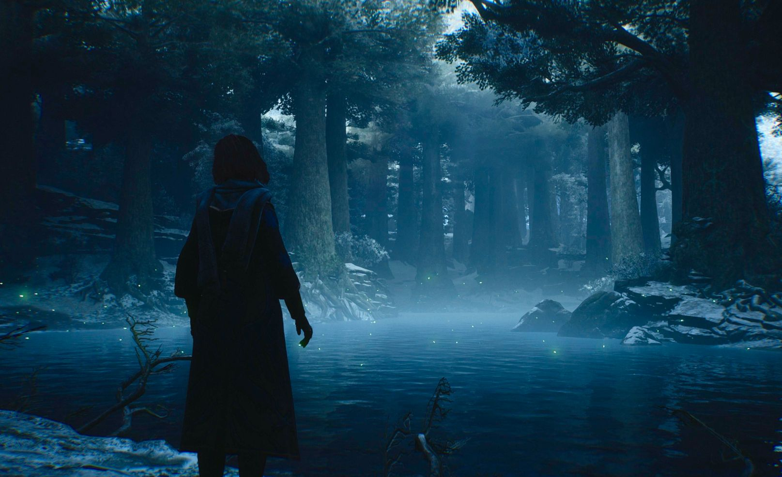

Slide 22


Slide 23

RIDDLE !!!!!

Slide 24
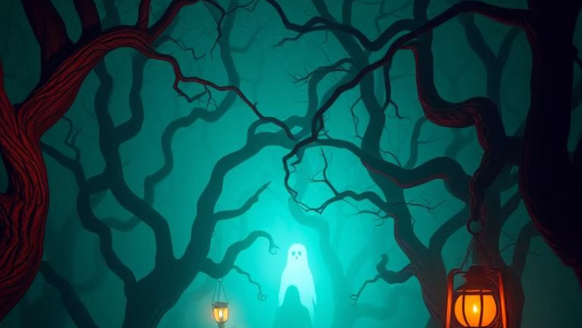
Will they escape, or will the forest claim them forever?

Slide 25
CRYPTIC CODEX
Fahim
Siam
Lutful
Jannat
Audhira
sunnah_75
AUDHIRA MUNTAHA
sidratul.audhira.251@northsouth.edu
audhira251

Slide 26


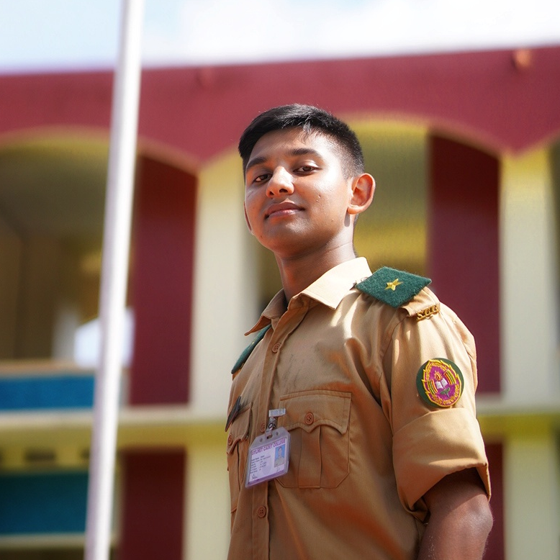
CRYPTIC CODEX
Samia
Audhira
Lutful
Jannat
Fahim
sterben.86
MD. FAHIM HOSSAIN
fahim.hossain.251@northsouth.edu
FahimHossain2186

Slide 27
UNRAVELING MYSTERY

Slide 28
FROM HELLO WORLD
TO ADVENTURE

Slide 29
FROM HELLO WORLD
TO ADVENTURE
#include <stdio.h>
int main() {
int choice;
printf("Welcome to the Dark Forest!\n");
printf("You are standing at a crossroads.\n");
printf("Press 1 to go left or 2 to go right: ");
scanf("%d", &choice);
if (choice == 1) {
printf("You walk into a deep fog and suddenly fall into a hidden pit. Game Over!\n");
} else if (choice == 2) {
printf("You find a treasure chest filled with gold. You Win!\n");
} else {
printf("You stand there, unable to decide, and a wild beast finds you. Game Over!\n");
}
return 0;
}
Online Submission:
The competition uses the possibilities of the modern internet to give all students the opportunity to participate regardless of nation, region, or school.

Slide 30
FROM HELLO WORLD
TO ADVENTURE
#include <stdio.h>
int main() {
int choice;
printf("Welcome to the Dark Forest!\n");
printf("You are standing at a crossroads.\n");
printf("Press 1 to go left or 2 to go right: ");
scanf("%d", &choice);
if (choice == 1) {
printf("You walk into a deep fog and suddenly fall into a hidden pit. Game Over!\n");
} else if (choice == 2) {
printf("You find a treasure chest filled with gold. You Win!\n");
} else {
printf("You stand there, unable to decide, and a wild beast finds you. Game Over!\n");
}
return 0;
}
Online Submission:
The competition uses the possibilities of the modern internet to give all students the opportunity to participate regardless of nation, region, or school.

Slide 31
FROM HELLO WORLD
TO ADVENTURE
#include <stdio.h>
int main() {
int choice;
printf("Welcome to the Dark Forest!\n");
printf("You are standing at a crossroads.\n");
printf("Press 1 to go left or 2 to go right: ");
scanf("%d", &choice);
if (choice == 1) {
printf("You walk into a deep fog and suddenly fall into a hidden pit. Game Over!\n");
} else if (choice == 2) {
printf("You find a treasure chest filled with gold. You Win!\n");
} else {
printf("You stand there, unable to decide, and a wild beast finds you. Game Over!\n");
}
return 0;
}
#include <stdio.h>
int main() {
int choice;
while (1) {
printf("Welcome to the Dark Forest!\n");
printf("You are standing at a crossroads.\n");
printf("Press 1 to go left, 2 to go right, or 3 to exit: ");
scanf("%d", &choice);
if (choice == 1) {
printf("You walk into a deep fog and suddenly fall into a hidden pit. Game Over!\n");
}
else if (choice == 2) {
printf("You find a treasure chest filled with gold. You Win!\n");
} else if (choice == 3) {
printf("Exiting the game...\n");
break;
} else {
printf("Invalid choice. Try again.\n");
}
}
return 0;
}

Slide 32
FROM HELLO WORLD
TO ADVENTURE
#include <stdio.h>
int main() {
int choice;
printf("Welcome to the Dark Forest!\n");
printf("You are standing at a crossroads.\n");
printf("Press 1 to go left or 2 to go right: ");
scanf("%d", &choice);
if (choice == 1) {
printf("You walk into a deep fog and suddenly fall into a hidden pit. Game Over!\n");
} else if (choice == 2) {
printf("You find a treasure chest filled with gold. You Win!\n");
} else {
printf("You stand there, unable to decide, and a wild beast finds you. Game Over!\n");
}
return 0;
}
#include <stdio.h>
int main() {
int choice;
while (1) {
printf("Welcome to the Dark Forest!\n");
printf("You are standing at a crossroads.\n");
printf("Press 1 to go left, 2 to go right, or 3 to exit: ");
scanf("%d", &choice);
if (choice == 1) {
printf("You walk into a deep fog and suddenly fall into a hidden pit. Game Over!\n");
}
else if (choice == 2) {
printf("You find a treasure chest filled with gold. You Win!\n");
} else if (choice == 3) {
printf("Exiting the game...\n");
break;
} else {
printf("Invalid choice. Try again.\n");
}
}
return 0;
}

Slide 33
#include <stdio.h>
int main() {
int choice;
while (1) {
printf("Welcome to the Dark Forest!\n");
printf("You are standing at a crossroads.\n");
printf("Press 1 to go left, 2 to go right, or 3 to exit: ");
scanf("%d", &choice);
if (choice == 1) {
printf("You walk into a deep fog and suddenly fall into a hidden pit. Game Over!\n");
}
else if (choice == 2) {
printf("You find a treasure chest filled with gold. You Win!\n");
} else if (choice == 3) {
printf("Exiting the game...\n");
break;
} else {
printf("Invalid choice. Try again.\n");
}
}
return 0;
}
FROM HELLO WORLD
TO ADVENTURE
#include <stdio.h>
int main() {
int choice;
printf("Welcome to the Dark Forest!\n");
printf("You are standing at a crossroads.\n");
printf("Press 1 to go left or 2 to go right: ");
scanf("%d", &choice);
if (choice == 1) {
printf("You walk into a deep fog and suddenly fall into a hidden pit. Game Over!\n");
} else if (choice == 2) {
printf("You find a treasure chest filled with gold. You Win!\n");
} else {
printf("You stand there, unable to decide, and a wild beast finds you. Game Over!\n");
}
return 0;
}

Slide 34
#include <stdio.h>
int main() {
int choice;
while (1) {
printf("Welcome to the Dark Forest!\n");
printf("You are standing at a crossroads.\n");
printf("Press 1 to go left, 2 to go right, or 3 to exit: ");
scanf("%d", &choice);
if (choice == 1) {
printf("You walk into a deep fog and suddenly fall into a hidden pit. Game Over!\n");
}
else if (choice == 2) {
printf("You find a treasure chest filled with gold. You Win!\n");
} else if (choice == 3) {
printf("Exiting the game...\n");
break;
} else {
printf("Invalid choice. Try again.\n");
}
}
return 0;
}
#include<stdio.h>
void credits() {
int dummy;
printf("\n\tCREDITS\t\n");
printf("\n2512847642\tMd. Fahim Hossain\n");
printf("2511026642\tSamia Zaman\n");
printf("2512244042\tRiazul Jannat\n");
printf("2513009642\tSidratul Muntahara Audhira\n");
printf("\nEnter any number to return to the main menu...\n");
scanf("%d", &dummy);
main();
}
void new_game(){
int choice;
printf("Some friends will go through an abandoned house which is known to be cursed.\n");
printf("So they are curious to know is it baseless or true.\n");
printf("Somehow they will end up being there and they will be trapped.\n");
printf("What will you do?\n");
printf("1. Explore Ground Floor.\n");
printf("2. Explore 1st Floor.\n");
scanf(“%d”,&choice);
}
int main(void){
int choice, exit_choice;
printf("Welcome to {Game Name}");
printf("\n1. NEW GAME\n2. CREDITS\n3. EXIT\n");
scanf("%d", &choice);
if (choice == 1)
new_game();
else if (choice == 2)
credits();
else if (choice == 3) {
printf("\nAre you sure you want to exit?");
printf("\n 1. Yes :( 2. No :D");
scanf("%d", &exit_choice);
if (exit_choice == 1)
printf("Exiting the Game.....\n");
else if (exit_choice == 2)
printf("\n");
main();
}
}
return 0;
}
FROM HELLO WORLD
TO ADVENTURE
#include <stdio.h>
int main() {
int choice;
printf("Welcome to the Dark Forest!\n");
printf("You are standing at a crossroads.\n");
printf("Press 1 to go left or 2 to go right: ");
scanf("%d", &choice);
if (choice == 1) {
printf("You walk into a deep fog and suddenly fall into a hidden pit. Game Over!\n");
} else if (choice == 2) {
printf("You find a treasure chest filled with gold. You Win!\n");
} else {
printf("You stand there, unable to decide, and a wild beast finds you. Game Over!\n");
}
return 0;
}

Slide 35
#include <stdio.h>
int main() {
int choice;
while (1) {
printf("Welcome to the Dark Forest!\n");
printf("You are standing at a crossroads.\n");
printf("Press 1 to go left, 2 to go right, or 3 to exit: ");
scanf("%d", &choice);
if (choice == 1) {
printf("You walk into a deep fog and suddenly fall into a hidden pit. Game Over!\n");
}
else if (choice == 2) {
printf("You find a treasure chest filled with gold. You Win!\n");
} else if (choice == 3) {
printf("Exiting the game...\n");
break;
} else {
printf("Invalid choice. Try again.\n");
}
}
return 0;
}
#include<stdio.h>
void credits() {
int dummy;
printf("\n\tCREDITS\t\n");
printf("\n2512847642\tMd. Fahim Hossain\n");
printf("2511026642\tSamia Zaman\n");
printf("2512244042\tRiazul Jannat\n");
printf("2513009642\tSidratul Muntahara Audhira\n");
printf("\nEnter any number to return to the main menu...\n");
scanf("%d", &dummy);
main();
}
void new_game(){
int choice;
printf("Some friends will go through an abandoned house which is known to be cursed.\n");
printf("So they are curious to know is it baseless or true.\n");
printf("Somehow they will end up being there and they will be trapped.\n");
printf("What will you do?\n");
printf("1. Explore Ground Floor.\n");
printf("2. Explore 1st Floor.\n");
scanf(“%d”,&choice);
}
int main(void){
int choice, exit_choice;
printf("Welcome to {Game Name}");
printf("\n1. NEW GAME\n2. CREDITS\n3. EXIT\n");
scanf("%d", &choice);
if (choice == 1)
new_game();
else if (choice == 2)
credits();
else if (choice == 3) {
printf("\nAre you sure you want to exit?");
printf("\n 1. Yes :( 2. No :D");
scanf("%d", &exit_choice);
if (exit_choice == 1)
printf("Exiting the Game.....\n");
else if (exit_choice == 2)
printf("\n");
main();
}
}
return 0;
}
FROM HELLO WORLD
TO ADVENTURE
#include <stdio.h>
int main() {
int choice;
printf("Welcome to the Dark Forest!\n");
printf("You are standing at a crossroads.\n");
printf("Press 1 to go left or 2 to go right: ");
scanf("%d", &choice);
if (choice == 1) {
printf("You walk into a deep fog and suddenly fall into a hidden pit. Game Over!\n");
} else if (choice == 2) {
printf("You find a treasure chest filled with gold. You Win!\n");
} else {
printf("You stand there, unable to decide, and a wild beast finds you. Game Over!\n");
}
return 0;
}

Slide 36
#include <stdio.h>
int main() {
int choice;
while (1) {
printf("Welcome to the Dark Forest!\n");
printf("You are standing at a crossroads.\n");
printf("Press 1 to go left, 2 to go right, or 3 to exit: ");
scanf("%d", &choice);
if (choice == 1) {
printf("You walk into a deep fog and suddenly fall into a hidden pit. Game Over!\n");
}
else if (choice == 2) {
printf("You find a treasure chest filled with gold. You Win!\n");
} else if (choice == 3) {
printf("Exiting the game...\n");
break;
} else {
printf("Invalid choice. Try again.\n");
}
}
return 0;
}
FROM HELLO WORLD
TO ADVENTURE
#include<stdio.h>
void credits() {
int dummy;
printf("\n\tCREDITS\t\n");
printf("\n2512847642\tMd. Fahim Hossain\n");
printf("2511026642\tSamia Zaman\n");
printf("2512244042\tRiazul Jannat\n");
printf("2513009642\tSidratul Muntahara Audhira\n");
printf("\nEnter any number to return to the main menu...\n");
scanf("%d", &dummy);
main();
}
void new_game(){
int choice;
printf("Some friends will go through an abandoned house which is known to be cursed.\n");
printf("So they are curious to know is it baseless or true.\n");
printf("Somehow they will end up being there and they will be trapped.\n");
printf("What will you do?\n");
printf("1. Explore Ground Floor.\n");
printf("2. Explore 1st Floor.\n");
scanf(“%d”,&choice);
}
int main(void){
int choice, exit_choice;
printf("Welcome to {Game Name}");
printf("\n1. NEW GAME\n2. CREDITS\n3. EXIT\n");
scanf("%d", &choice);
if (choice == 1)
new_game();
else if (choice == 2)
credits();
else if (choice == 3) {
printf("\nAre you sure you want to exit?");
printf("\n 1. Yes :( 2. No :D");
scanf("%d", &exit_choice);
if (exit_choice == 1)
printf("Exiting the Game.....\n");
else if (exit_choice == 2)
printf("\n");
main();
}
}
return 0;
}

Slide 37
#include <stdio.h>
int main() {
int choice;
while (1) {
printf("Welcome to the Dark Forest!\n");
printf("You are standing at a crossroads.\n");
printf("Press 1 to go left, 2 to go right, or 3 to exit: ");
scanf("%d", &choice);
if (choice == 1) {
printf("You walk into a deep fog and suddenly fall into a hidden pit. Game Over!\n");
}
else if (choice == 2) {
printf("You find a treasure chest filled with gold. You Win!\n");
} else if (choice == 3) {
printf("Exiting the game...\n");
break;
} else {
printf("Invalid choice. Try again.\n");
}
}
return 0;
}
FROM HELLO WORLD
TO ADVENTURE
#include<stdio.h>
void credits() {
int dummy;
printf("\n\tCREDITS\t\n");
printf("\n2512847642\tMd. Fahim Hossain\n");
printf("2511026642\tSamia Zaman\n");
printf("2512244042\tRiazul Jannat\n");
printf("2513009642\tSidratul Muntahara Audhira\n");
printf("\nEnter any number to return to the main menu...\n");
scanf("%d", &dummy);
main();
}
void new_game(){
int choice;
printf("Some friends will go through an abandoned house which is known to be cursed.\n");
printf("So they are curious to know is it baseless or true.\n");
printf("Somehow they will end up being there and they will be trapped.\n");
printf("What will you do?\n");
printf("1. Explore Ground Floor.\n");
printf("2. Explore 1st Floor.\n");
scanf(“%d”,&choice);
}
int main(void){
int choice, exit_choice;
printf("Welcome to {Game Name}");
printf("\n1. NEW GAME\n2. CREDITS\n3. EXIT\n");
scanf("%d", &choice);
if (choice == 1)
new_game();
else if (choice == 2)
credits();
else if (choice == 3) {
printf("\nAre you sure you want to exit?");
printf("\n 1. Yes :( 2. No :D");
scanf("%d", &exit_choice);
if (exit_choice == 1)
printf("Exiting the Game.....\n");
else if (exit_choice == 2)
printf("\n");
main();
}
}
return 0;
}
#include <stdlib.h>
int get_choice(int num_choices) {
int choice;
printf("\nEnter your choice (1 to %d): ", num_choices);
scanf("%d", &choice);
while (getchar() != '\n'); // Clear input buffer
if (choice >= 1 && choice <= num_choices)
return choice;
else {
printf("Invalid choice. Please try again.\n");
return get_choice(num_choices); }
}
void game_over(){
printf("Game Over.\n");
printf("Press ENTER to return to the main menu...\n");
// ENTER to be back to MAIN MENU
getchar();
while (getchar() != '\n');
main();
}

Slide 38
#include <stdio.h>
int main() {
int choice;
while (1) {
printf("Welcome to the Dark Forest!\n");
printf("You are standing at a crossroads.\n");
printf("Press 1 to go left, 2 to go right, or 3 to exit: ");
scanf("%d", &choice);
if (choice == 1) {
printf("You walk into a deep fog and suddenly fall into a hidden pit. Game Over!\n");
}
else if (choice == 2) {
printf("You find a treasure chest filled with gold. You Win!\n");
} else if (choice == 3) {
printf("Exiting the game...\n");
break;
} else {
printf("Invalid choice. Try again.\n");
}
}
return 0;
}
FROM HELLO WORLD
TO ADVENTURE
#include<stdio.h>
void credits() {
int dummy;
printf("\n\tCREDITS\t\n");
printf("\n2512847642\tMd. Fahim Hossain\n");
printf("2511026642\tSamia Zaman\n");
printf("2512244042\tRiazul Jannat\n");
printf("2513009642\tSidratul Muntahara Audhira\n");
printf("\nEnter any number to return to the main menu...\n");
scanf("%d", &dummy);
main();
}
void new_game(){
int choice;
printf("Some friends will go through an abandoned house which is known to be cursed.\n");
printf("So they are curious to know is it baseless or true.\n");
printf("Somehow they will end up being there and they will be trapped.\n");
printf("What will you do?\n");
printf("1. Explore Ground Floor.\n");
printf("2. Explore 1st Floor.\n");
scanf(“%d”,&choice);
}
int main(void){
int choice, exit_choice;
printf("Welcome to {Game Name}");
printf("\n1. NEW GAME\n2. CREDITS\n3. EXIT\n");
scanf("%d", &choice);
if (choice == 1)
new_game();
else if (choice == 2)
credits();
else if (choice == 3) {
printf("\nAre you sure you want to exit?");
printf("\n 1. Yes :( 2. No :D");
scanf("%d", &exit_choice);
if (exit_choice == 1)
printf("Exiting the Game.....\n");
else if (exit_choice == 2)
printf("\n");
main();
}
}
return 0;
}
#include <stdlib.h>
int get_choice(int num_choices) {
int choice;
printf("\nEnter your choice (1 to %d): ", num_choices);
scanf("%d", &choice);
while (getchar() != '\n'); // Clear input buffer
if (choice >= 1 && choice <= num_choices)
return choice;
else {
printf("Invalid choice. Please try again.\n");
return get_choice(num_choices); }
}
void game_over(){
printf("Game Over.\n");
printf("Press ENTER to return to the main menu...\n");
// ENTER to be back to MAIN MENU
getchar();
while (getchar() != '\n');
main();
}

Slide 39
#include <stdio.h>
int main() {
int choice;
while (1) {
printf("Welcome to the Dark Forest!\n");
printf("You are standing at a crossroads.\n");
printf("Press 1 to go left, 2 to go right, or 3 to exit: ");
scanf("%d", &choice);
if (choice == 1) {
printf("You walk into a deep fog and suddenly fall into a hidden pit. Game Over!\n");
}
else if (choice == 2) {
printf("You find a treasure chest filled with gold. You Win!\n");
} else if (choice == 3) {
printf("Exiting the game...\n");
break;
} else {
printf("Invalid choice. Try again.\n");
}
}
return 0;
}
#include <stdlib.h>
int get_choice(int num_choices) {
int choice;
printf("\nEnter your choice (1 to %d): ", num_choices);
scanf("%d", &choice);
while (getchar() != '\n'); // Clear input buffer
if (choice >= 1 && choice <= num_choices)
return choice;
else {
printf("Invalid choice. Please try again.\n");
return get_choice(num_choices); }
}
void game_over(){
printf("Game Over.\n");
printf("Press ENTER to return to the main menu...\n");
// ENTER to be back to MAIN MENU
getchar();
while (getchar() != '\n');
main();
}
FROM HELLO WORLD
TO ADVENTURE
#include<stdio.h>
void credits() {
int dummy;
printf("\n\tCREDITS\t\n");
printf("\n2512847642\tMd. Fahim Hossain\n");
printf("2511026642\tSamia Zaman\n");
printf("2512244042\tRiazul Jannat\n");
printf("2513009642\tSidratul Muntahara Audhira\n");
printf("\nEnter any number to return to the main menu...\n");
scanf("%d", &dummy);
main();
}
void new_game(){
int choice;
printf("Some friends will go through an abandoned house which is known to be cursed.\n");
printf("So they are curious to know is it baseless or true.\n");
printf("Somehow they will end up being there and they will be trapped.\n");
printf("What will you do?\n");
printf("1. Explore Ground Floor.\n");
printf("2. Explore 1st Floor.\n");
scanf(“%d”,&choice);
}
int main(void){
int choice, exit_choice;
printf("Welcome to {Game Name}");
printf("\n1. NEW GAME\n2. CREDITS\n3. EXIT\n");
scanf("%d", &choice);
if (choice == 1)
new_game();
else if (choice == 2)
credits();
else if (choice == 3) {
printf("\nAre you sure you want to exit?");
printf("\n 1. Yes :( 2. No :D");
scanf("%d", &exit_choice);
if (exit_choice == 1)
printf("Exiting the Game.....\n");
else if (exit_choice == 2)
printf("\n");
main();
}
}
return 0;
}

Slide 40


CRYPTIC CODEX
Samia
Audhira
Lutful
Jannat
Fahim
sterben.86
MD. FAHIM HOSSAIN
fahim.hossain.251@northsouth.edu
FahimHossain2186

Slide 41



CRYPTIC CODEX
Fahim
Audhira
Lutful
Jannat
Lutful-alam-36300
MD. LUTFUL ALAM
lutful.alam.241@northsouth.edu
Lutful-alam

Slide 42
FROM HELLO WORLD
TO ADVENTURE

Slide 43
GAME FLOW

Slide 44
ENTER THE MANSION
Forest
journey
STAY OUTSIDE
GAME FLOW
! KNOCK !
!! KNOCK !!

Slide 45
ENTER THE MANSION
GAME FLOW

Slide 46
SOUND !!
IGNORE
NOISE ??
INVESTIGATE
ENTER THE MANSION
Abandoned mansion
BREAK THE WINDOW
GAME FLOW
SPLIT UP AND SEARCH
Forest
journey
STAY OUTSIDE
! KNOCK !
!! KNOCK !!

Slide 47
NOISE ??
INVESTIGATE
GAME FLOW

Slide 48
PUTTING THE PAINTING OFF
NOISE ??
INVESTIGATE
VANISHING PORTRAITS
KNOCK !!
WHO IS THERE!
GAME FLOW
EXAMINE THE
PAINTING
Forest
journey
STAY OUTSIDE
! KNOCK !
!! KNOCK !!

Slide 49
KNOCK !!
WHO IS THERE!
Game over
GAME FLOW

Slide 50
GAME FLOW

Slide 51
UPCOMING UPGRADES

Slide 52
UPCOMING UPGRADES
RANDOM
EVENTS
MULTIPLE
ENDINGS
SAVE
& LOAD
03
04
02
INVENTORY
PLAYER PROFILE
05
01
GUI
06

Slide 53
UPCOMING UPGRADES
RANDOM
EVENTS
MULTIPLE
ENDINGS
SAVE
& LOAD
03
04
02
INVENTORY
PLAYER PROFILE
05
01
GUI
06

Slide 54
UPCOMING UPGRADES

Slide 55

THE JOURNEY ENDS
ANY QUESTIONS ??

Slide 56


Slide 57
EXAMINE THE
PAINTING
GAME FLOW

Slide 58
CLOSE THE BOOK
EXAMINE THE
PAINTING
WISHPERING
BOOKSHELF
BURN THE BOOKSHELF
GAME FLOW
PULL THE WHISPERING BOOK
Forest
journey
STAY OUTSIDE
! KNOCK !
!! KNOCK !!

Slide 59
PULL THE WHISPERING BOOK
GAME FLOW

Slide 60
A COMPASS
A WALL CLOCK
PULL THE WHISPERING BOOK
RIDDLE
A COMBINATION LOCK
GAME FLOW
A WATCH
Forest
journey
STAY OUTSIDE
! KNOCK !
!! KNOCK !!

